Slide 1
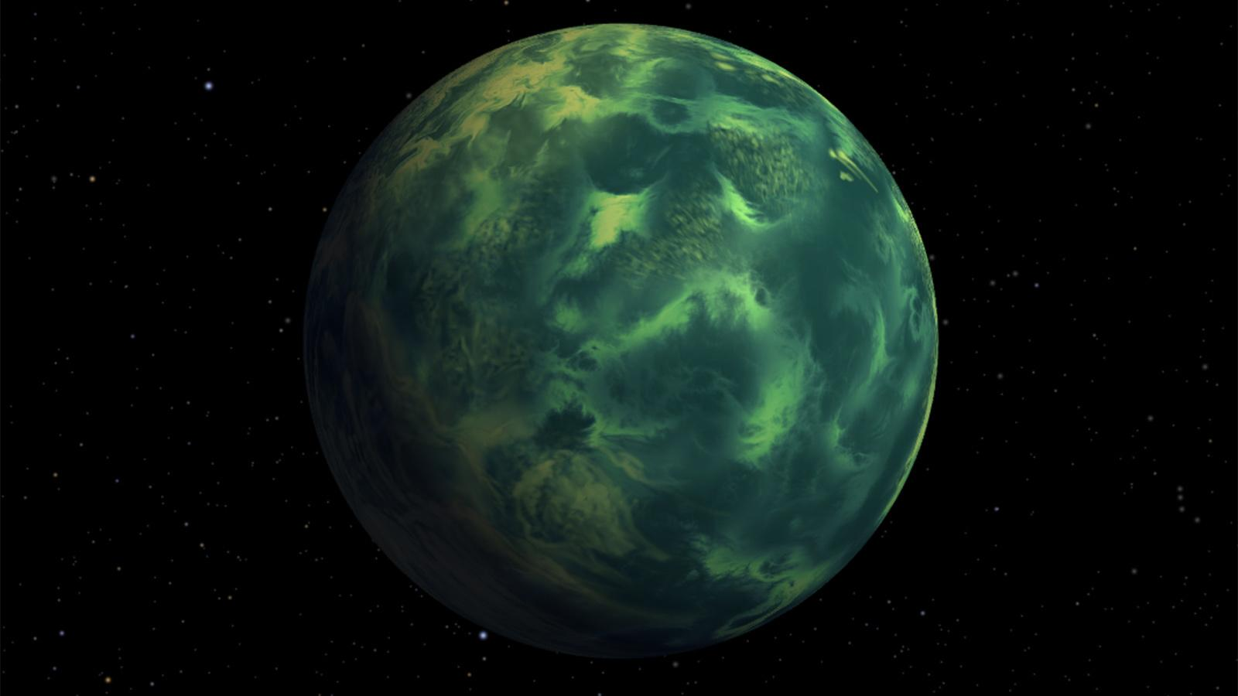
Exoplanet Data Science Project
By: Shreeyan Veera Pampana

Slide 2
What Are Exoplanets?
Exoplanets are planets that exist outside our solar system. They come in many kinds; some are gas giants, some are rocky planets, and other are completely unlike anything in this solar system.
Why study exoplanets?
To search for life – to find planets containing the right conditions for life.
Solar system formation – Comparing planets around different stars helps us understand how solar systems form.
Earth-like Planets – helps engineers understand which planets could support human life.
Understand Our Universe – understand just how diverse and dynamic our universe is.

Slide 3
Are there any habitable planets?
As for the planets that are anomalies, how does their mass to radius ratio differ from the majority of planets?
How strong is the connection between mass and radius?
Using Python and pandas, I was able to answer all these questions, and more!
Questions

Slide 4
Project Objectives
Analyze graphs of exoplanet mass, radius, and orbital period generated through Python coding.
Create 3 clusters of exoplanets based on shared characteristics: mass, radius, and orbital period.
Identify how strong the relationship is between mass and radius.
Detect anomalies in the mass-to-radius ratios of exoplanets.
Search for potentially habitable planets based on these analyses.

Slide 5
About The Data
The datasets used for this project came from two sources: NASA Exoplanet Query and Catalogue of Exoplanets (from EU).
The key properties studied were mass, radius, orbital period, star distance, density, star mass, and star radius.
Some of the data contained missing values, so I eliminated those entire rows for more accuracy.

Slide 6
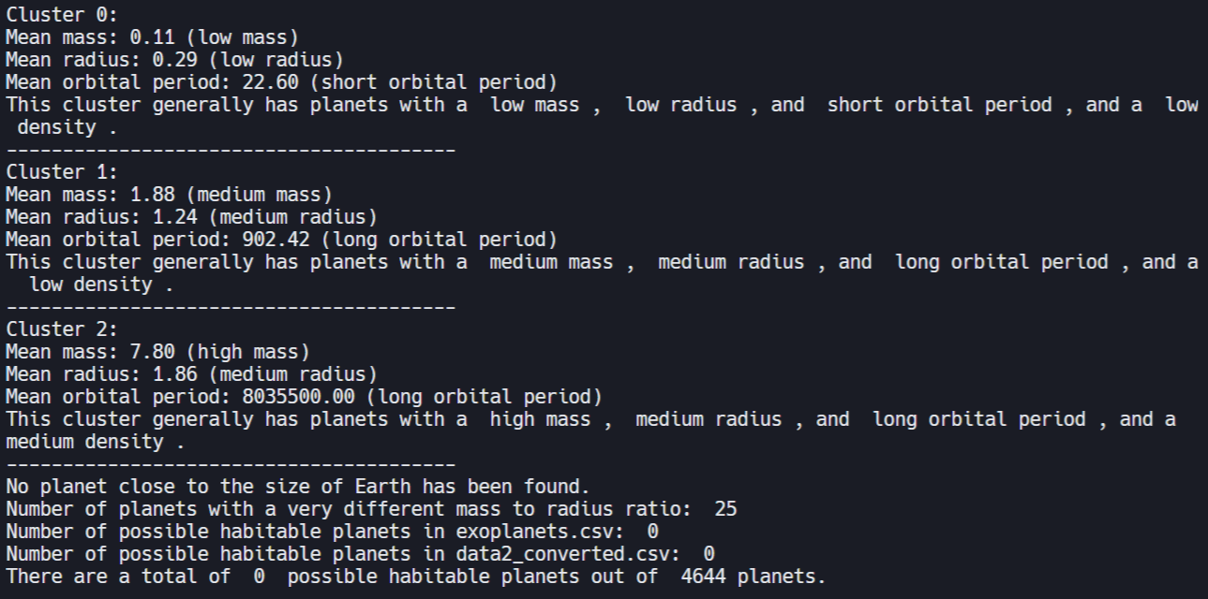
Exploring the Data
I developed Python code (K-Means algorithm) utilizing the pandas library to analyze data from the Catalogue of Exoplanets (.csv) by splitting all the planets into three clusters: Cluster 0, Cluster 1, and Cluster 2. Each cluster had similar properties in mass, radius, and orbital period.

Slide 7
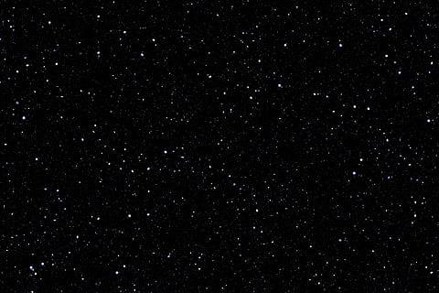
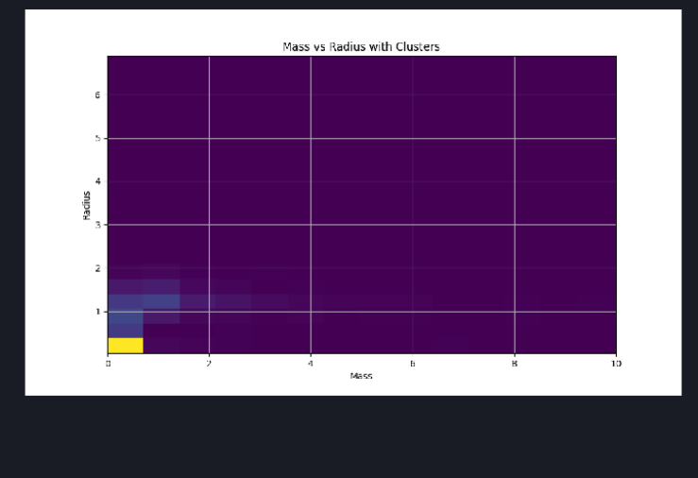
Planet’s Mass, Radius & Orbital Period
Then, I developed Python code (matplotlib) using pandas to visualize the similar properties of each cluster through graphical representations.
Histogram of mass and radius, with clusters.

Slide 8
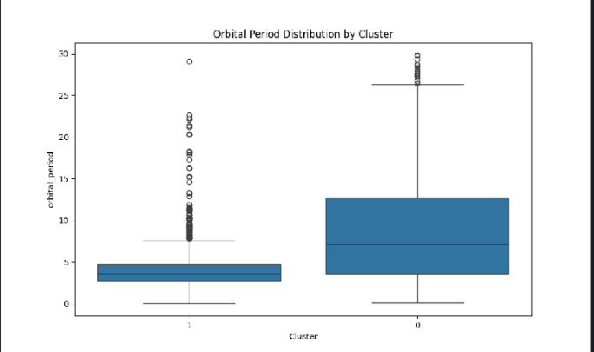
Clusters
Additionally, I implemented Python code (matplotlib & K-Means algorithm) with pandas to illustrate all the orbital periods within each cluster.
Shows Cluster 0 and Cluster 1, and the orbital periods of these clusters.

Slide 9
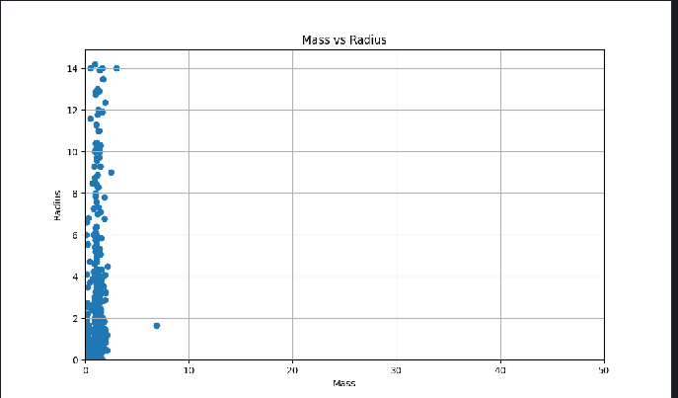
Mass vs. Radius
I created Python code (matplotlib )using the pandas library to graph the mass and radius of all the planets.
Scatterplot of mass and radius, without clusters.

Slide 10
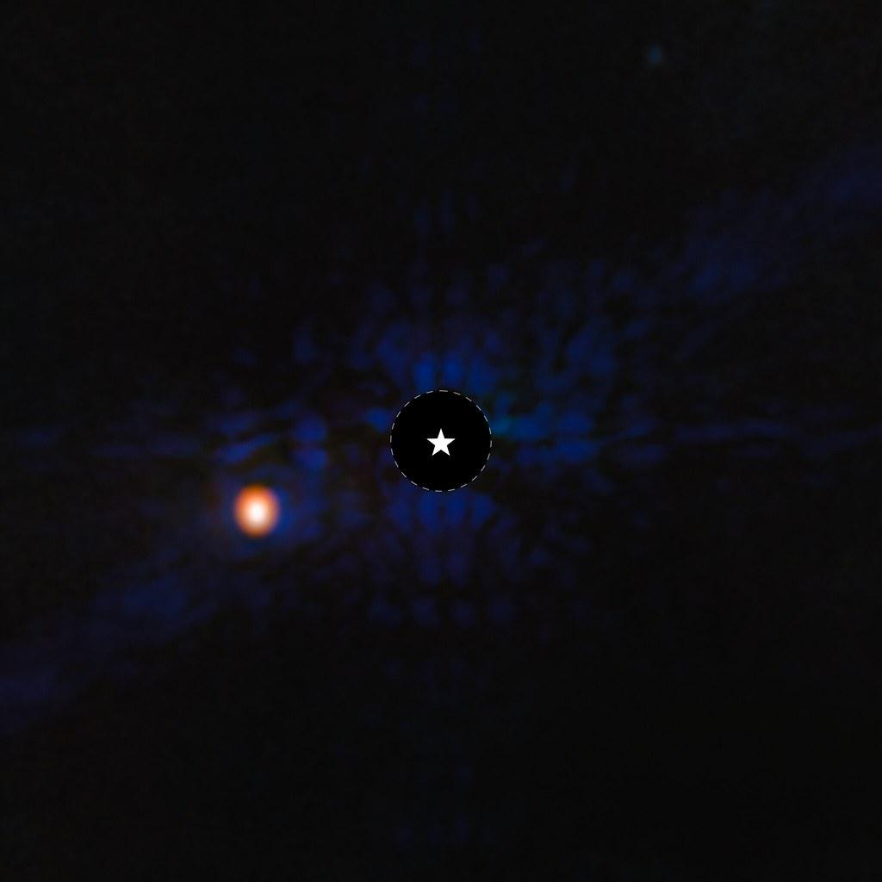
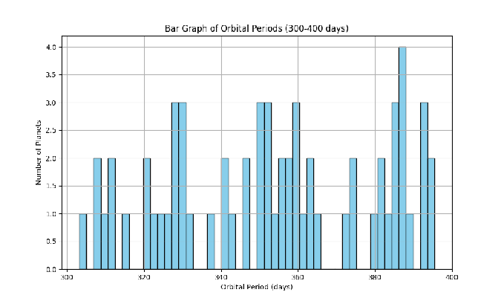
Orbital Period
I generated Python code (matplotlib) using pandas to show the distribution of orbital periods.
Bar graph of orbital period and number of planets.

Slide 11
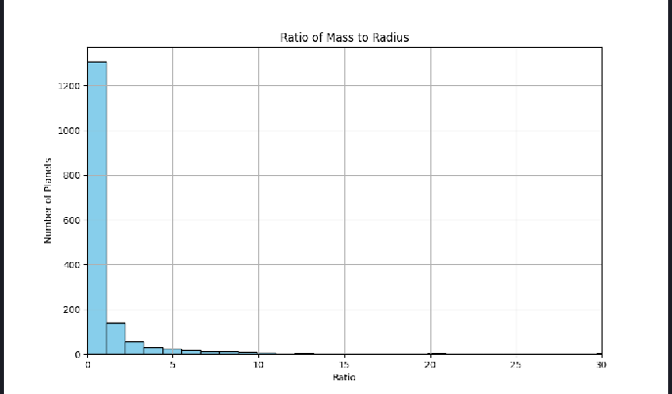
Mass to Radius Ratio

Slide 12
Surprisingly, the connection isn’t that strong! The correlation coefficient (about 0.41) means that the correlation between mass and radius is about 0.41. This implies a weak relationship between mass and radius (in a linear model).
This idea is revolutionary because it helps us better understand the complexity of planet formation, gives us better insight into planet composition, enhances habitability assessments, and way more!
How strong is the connection between mass and radius?

Slide 13
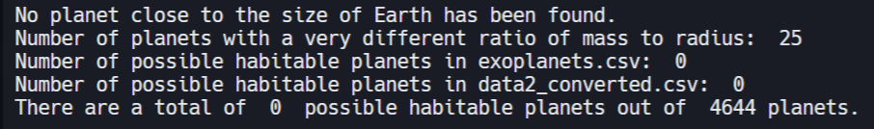
Habitable Planets & Anomalies
This shows that there are 25 planets with a very different mass to radius ratio (anomalies). It also shows that out of 4644 planets, none of them are likely habitable!!!

Slide 14
In our context, an anomaly is a planet with a very different mass to radius ratio from the majority of planets. Looking at the Mass to Radius Ratio graph shows that most planets have a lower ratio.
Also, the planets generally had a lower ratio for two of the clusters and medium ratio in the other cluster, as shown in the output. (Density is similar to the mass to radius ratio.)
Thus, we can conclude that the mass to radius ratio of anomalies are higher than most planets.
We can make even more conclusions about this. For example, since the density of these planets are way bigger, the planet is likely a rocky one. All 25 of these anomalies have such a big density that they are all likely to be rocky planets. These planets could be very valuable to study.
As for the anomalies, how to the mass to radius ratio of these planets differ from the majority of planets?

Slide 15
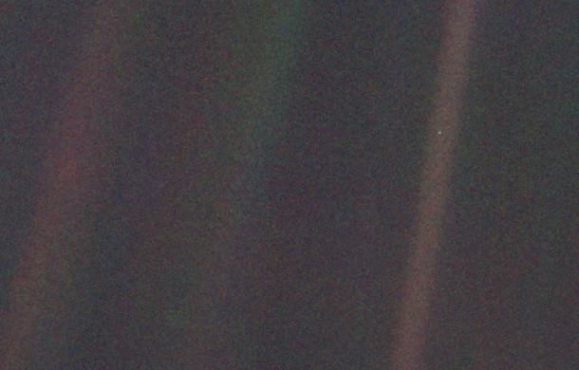
Conclusions
So far, there don’t seem to be any habitable planets other than Earth. If this comes out to be true, it would be extremely revolutionary. It would redefine exoplanet science, challenge the long held view of Earth not being unique in the universe, and emphasizes the importance of preserving Earth.
There are 25 planets that have a very different mass to radius ratio than the majority. The ratios for these planets are way higher than average. This conclusion leads to the fact that they are almost certainly rocky planets, which could be insanely valuable.
Mass and radius aren’t that strongly related. This is significant, since we can better assess planet composition, perform finer habitability assessments, and understand the complexity of planet formation.

Slide 16
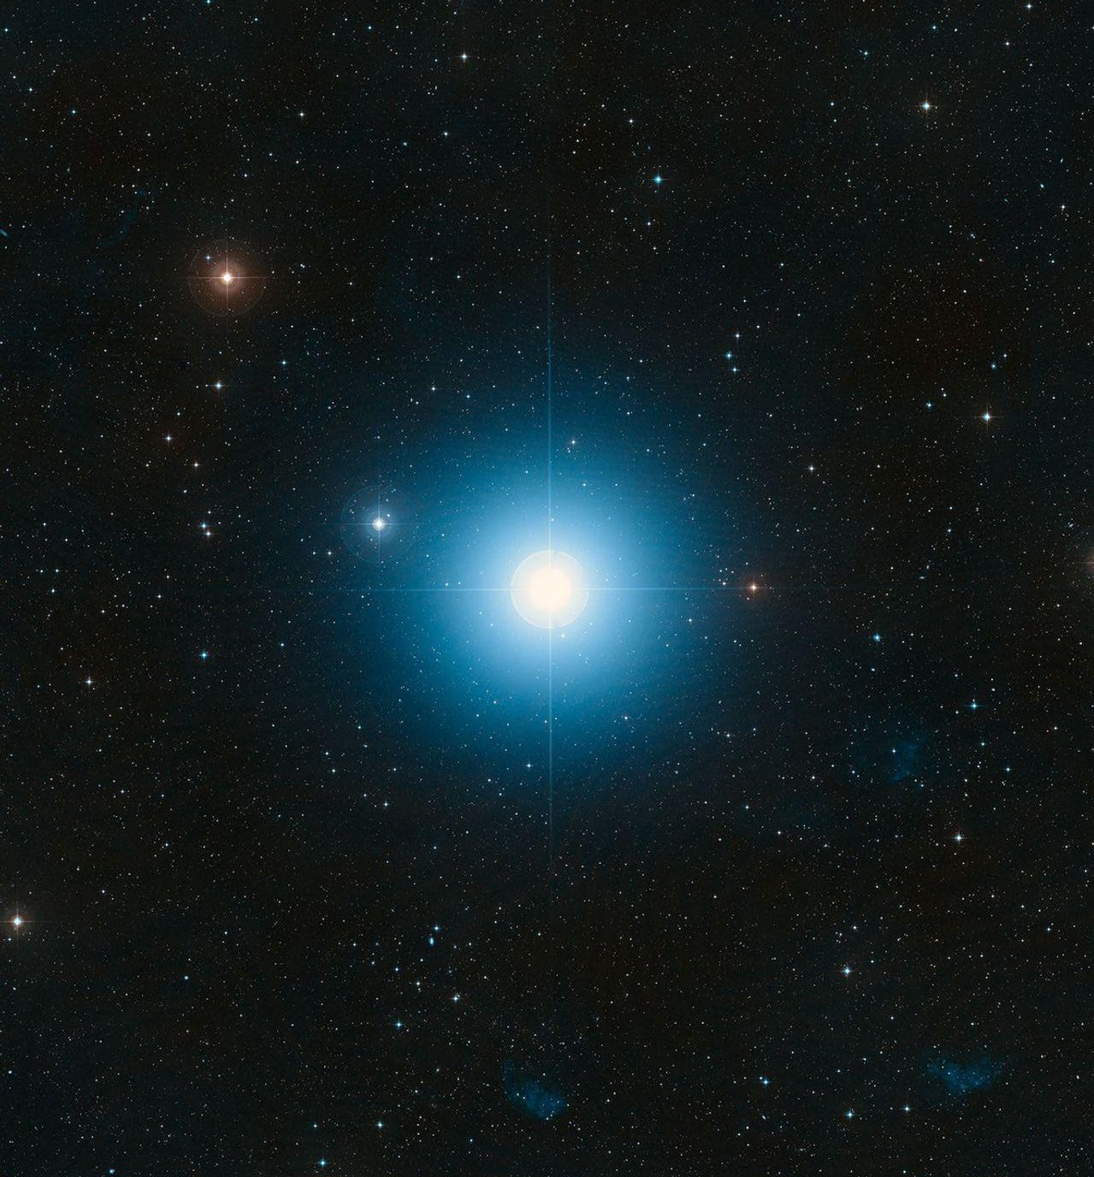
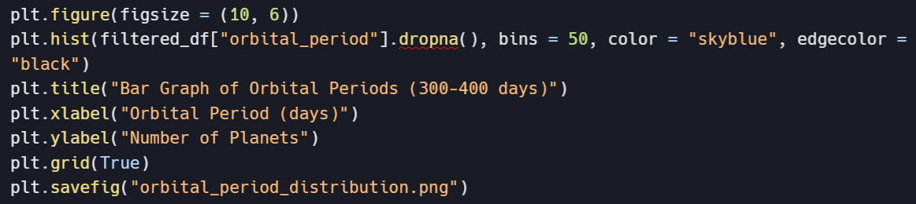
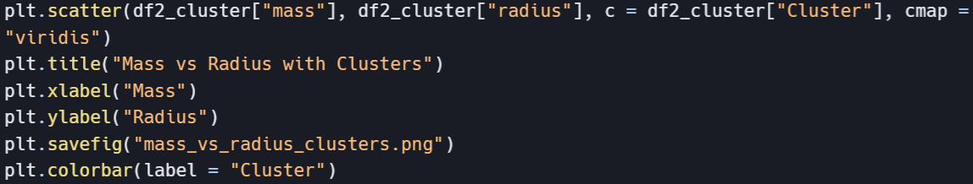
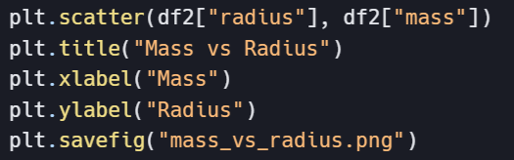
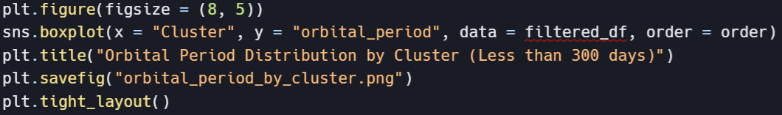
Generation of Graphs

Slide 17
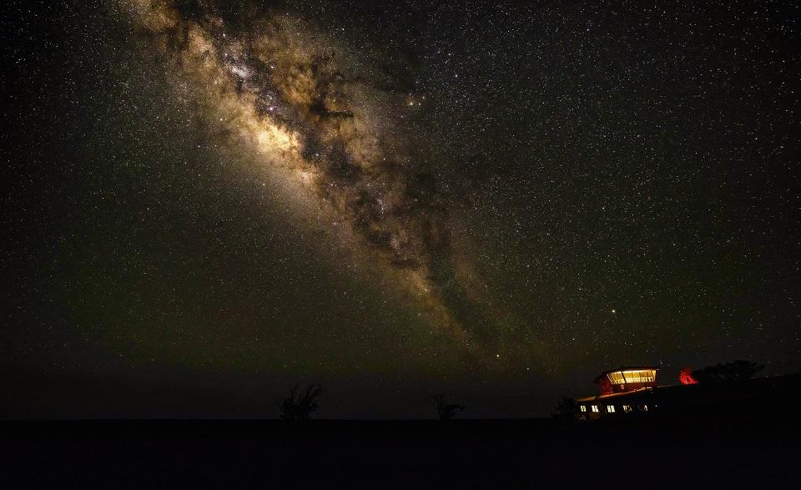
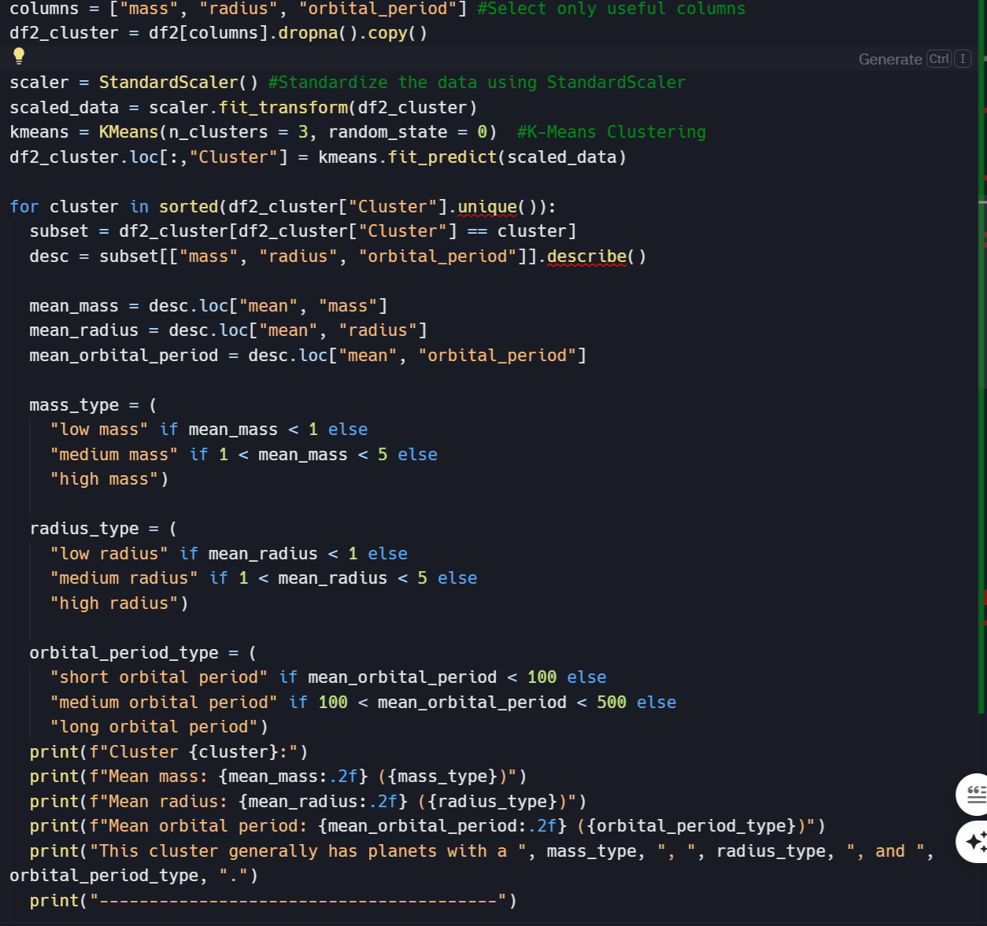
Clustering Data:

Slide 18
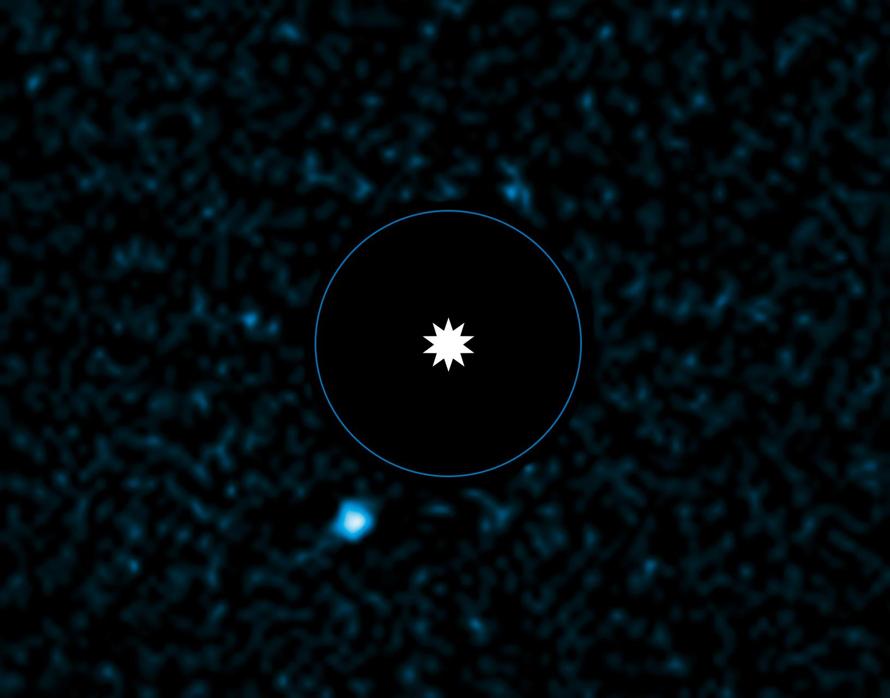
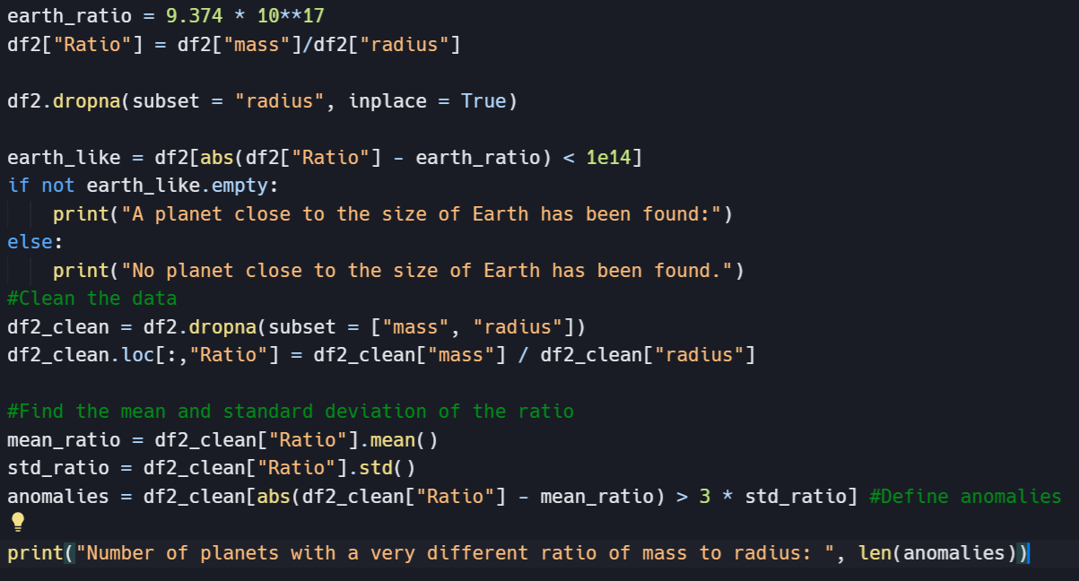
Detecting anomalies & assessing planets close to the size of Earth:

Slide 19
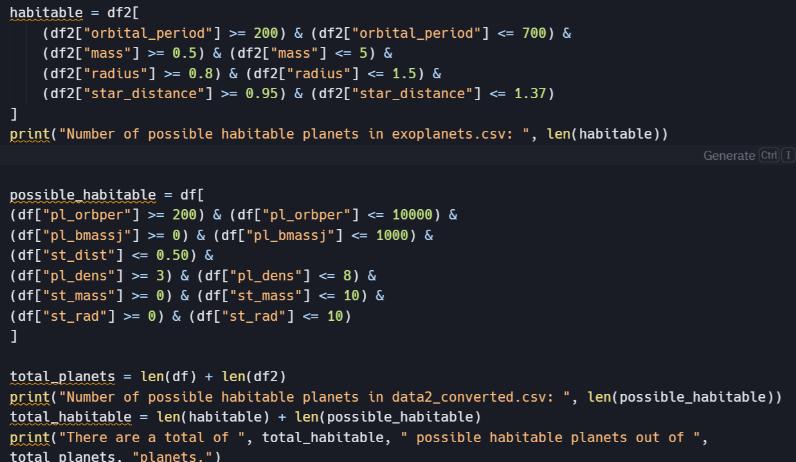
Detecting Habitable Planets

